Slide 1
Aiming Shooting Game
Dimitrios Valeris(6175579)-Anastasios Latos(6309070)

Slide 2
Our Goal
Take practicals to the next level.
Use physics we learn for a shooting simulator.

Slide 3
First Idea
Dart Game
Users are able to adjust the power and the angle of throwing in x, y axis
Additional values
Random wind value in scene
Movement “Path” Prediction

Slide 4
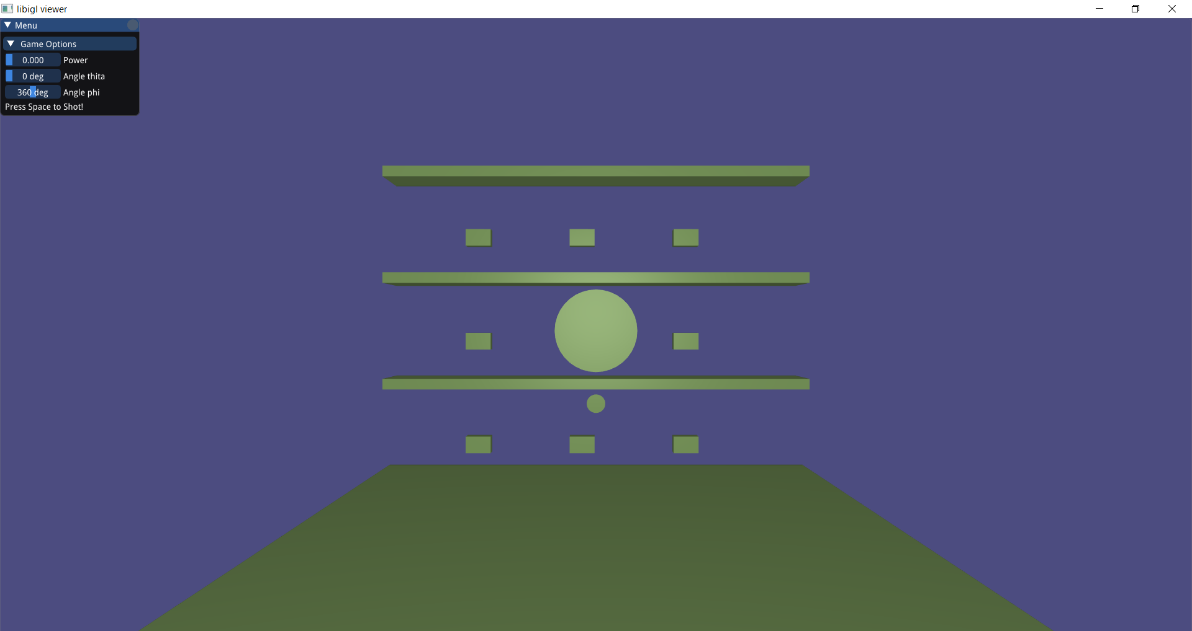
Final Implementation Scene

Slide 5
Final Implementation
Values of final implementation
Human force (Average human force ~ 400 N)
Theta angle (to analyse the human force to xyz)
Phi angle (to analyse the human force to xyz)
Random wind resist (From 0 N to 5 N)
Angles Theta,Phi for wind (Random angle from 0 to 360)

Slide 6
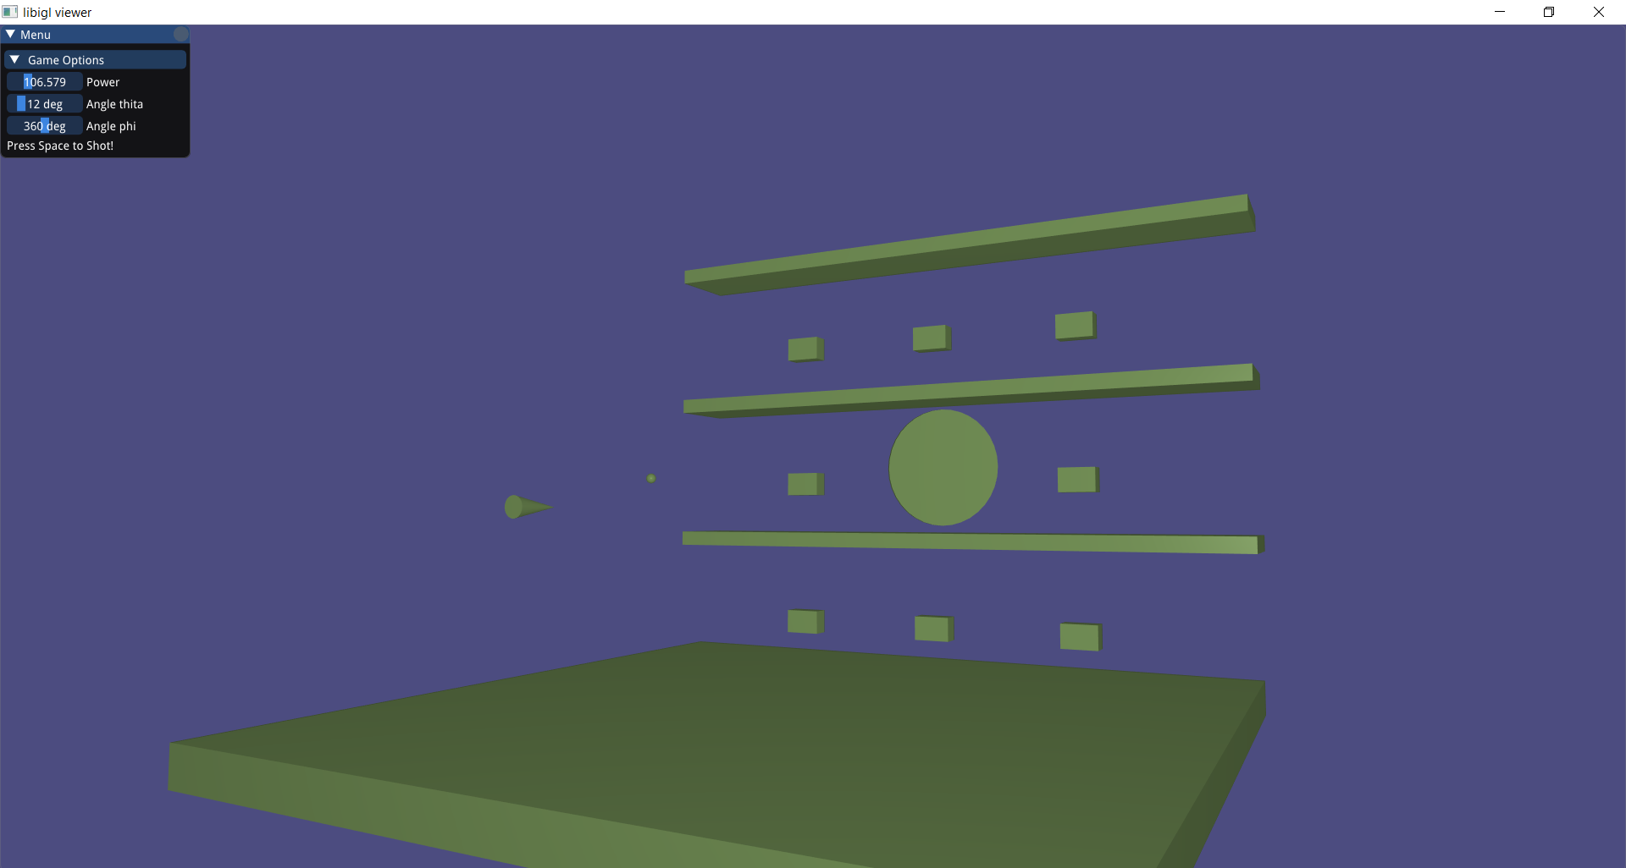
Path Prediction

Slide 7
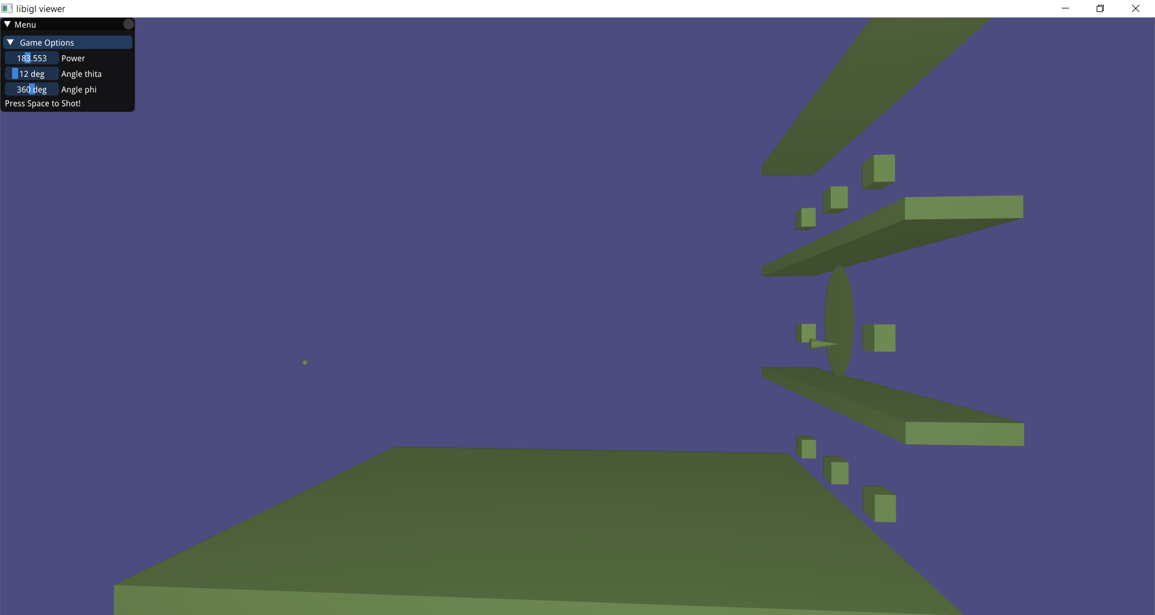
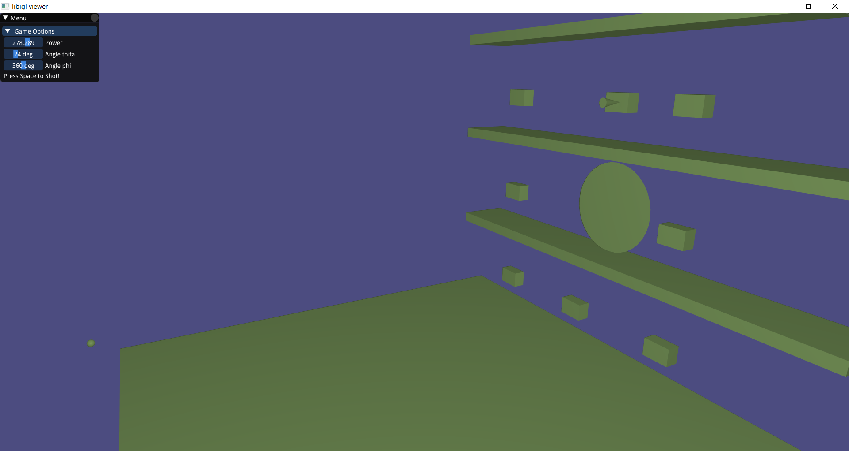
Examples of successful shot

Slide 8
Live Demo

